Slide 1
Attendance Management System

Slide 2

Opening Page of the website
The student have to enter the login credentials
Click on login button

Slide 3
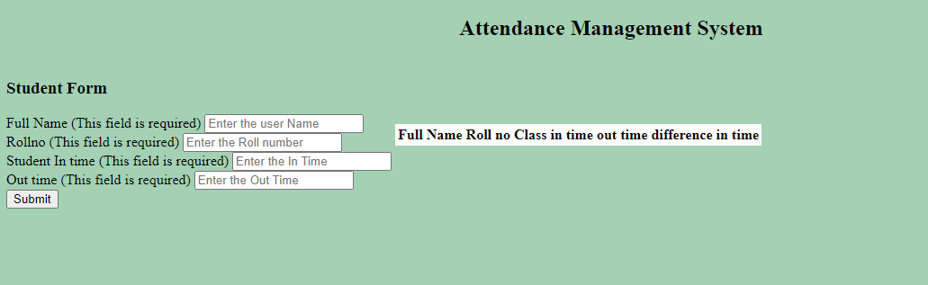
PAGE 2
PAGE 2
The student has to enter the name, roll number,intime,outtime.
Then click on SUBMIT button.

Slide 4
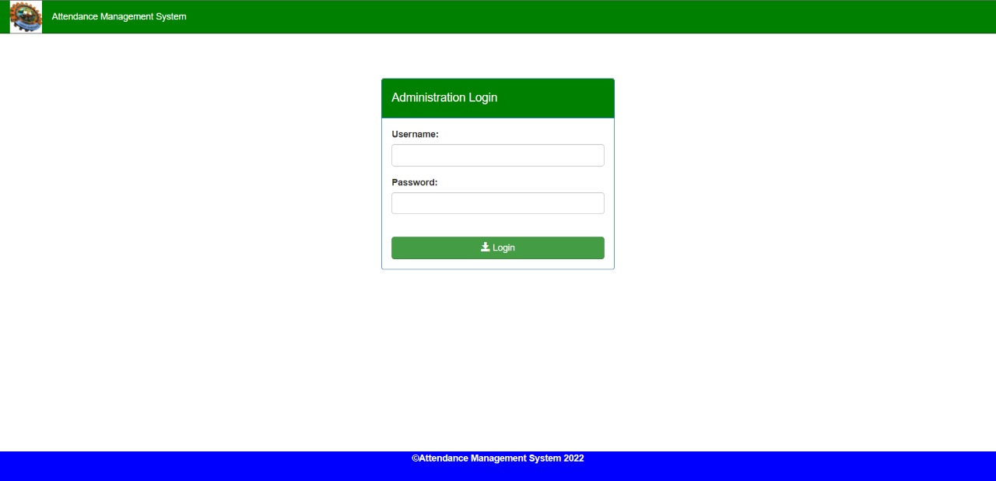
Admin login

Slide 5
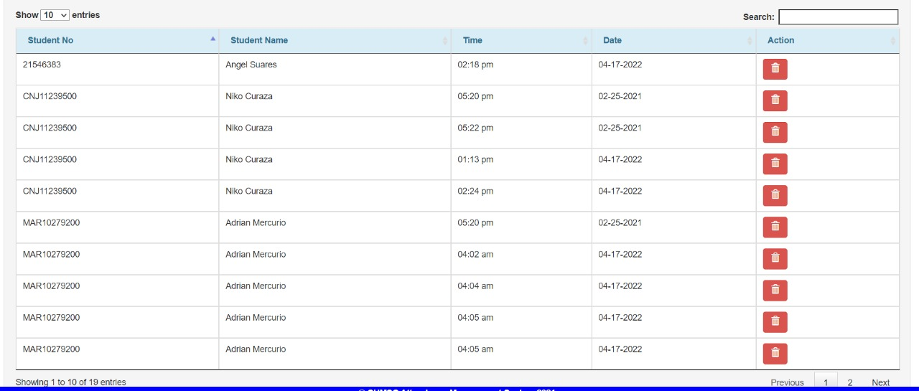
RECORD

